Slide 1



Introduction to reinforcement learning
San Diego machine Learning
May 15, 2021

Slide 2
How to Participate
One discussion leader, and everyone welcome to participate
Majority of material comes from Reinforcement Learning by Sutton and Barto
Options to approach the content:
Treat this as a standalone webinar
Read the book first, and come with questions and discussion items
Use this meetup as a primer and read the chapters afterward
Ask questions
Give feedback. Too fast or too slow? Want to see more of something or less of something else?
Have fun!

Slide 3

Agenda
Explain what reinforcement learning (RL) is and how it differs from supervised and unsupervised learning
Describe the basic elements of RL
Define RL in terms of Markov decision processes
Introduce the terminology and notation used in RL
Show the Bellman equations and simple ways to read them
Show how optimal solutions can be found for very simple RL problems
Share some of the challenges with general RL problems
Give a taste for what more advanced RL algorithms do
Math

Slide 4
Kinds of Machine Learning
Reinforcement learning (RL) is about an agent learning from interacting with its uncertain environment
The agent interacts by choosing from a set of allowed actions
It gets feedback from a numeric reward signal
Goal is to maximize the total rewards received
Supervised learning is learning from ground truth labels
Many problems don’t have sufficient representative examples, e.g. backgammon, or experts don’t even know the best actions
Unsupervised learning might seem similar, also no labels
But unsupervised learning doesn’t have an environment or a reward signal

Slide 5
Examples of Reinforcement Learning
Many kinds of problems can easily be posed as a RL problem, with an agent that sequentially chooses actions in an environment that represents everything not under the direct control of the agent
Chess or Atari games
Control a power station
Manage an investment portfolio
Navigate a maze
Make a robot walk
What other examples can you come up with?
Note that the agent boundary can be set in different places, and sometimes smaller RL problems are nested inside others

Slide 6
Reinforcement Learning
Reinforcement learning is about exploring the environment and recording useful information for the future
RL is sequential decision making; time is intrinsic
Situations that look similar might differ due to history
Good or bad consequences might lie far into the future
The environment might be stationary (unchanging) or dynamic
In dynamic environments, more explore/exploit tradeoff concerns
We want a way to model this potentially very complex interaction of the agent with the environment over time

Slide 7
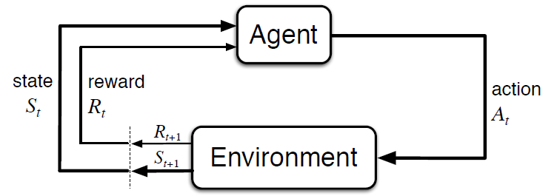
Markov Decision Processes
Elements of the fully observable Markov Decision Process (MDP):
State - at each time step t, the environment is in some state S_{t}
Action - at each time step t, the agent chooses an action A_{t}
Reward - after taking the action, the agent is given a reward signal R_{t+1} and subsequently finds itself in a new state S_{t+1}
Repeating the above process creates a trajectory like this: S₀, A₀, R₁, S₁, A₁, R₂, S₂, A₂, R₃, ...

Slide 8
Markov Decision Processes
In a Markov Decision Process, the transition at any given time t only depends on the state S_{t} and action chosen A_{t}
The transition must not depend on any history prior to S_{t} (memoryless)
Said another way, the state S_{t} must include any information from the past needed to understand the future
E.g. if you’re playing Pac-Man, even if you, the ghosts, and everything else on the screen is identical, the state is not the same if you have one life left vs. three lives left. Therefore, the state at any time must include the number of lives.
The transitions can be deterministic (e.g. chess) or stochastic (e.g. a slot machine)
We can model everything as stochastic, where deterministic transitions will have probability 1

Slide 9
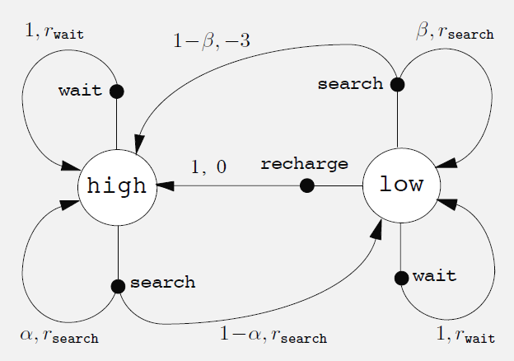
MDPs as a Graph
Sometimes it is easier to visualize a MDP as a directed graph
The states are nodes (big white circles)
The actions are edges leading from nodes (here with small black circles)
The rewards are values along directed edges that take you to a new state
Here is the recycling robot from the book:

Slide 10
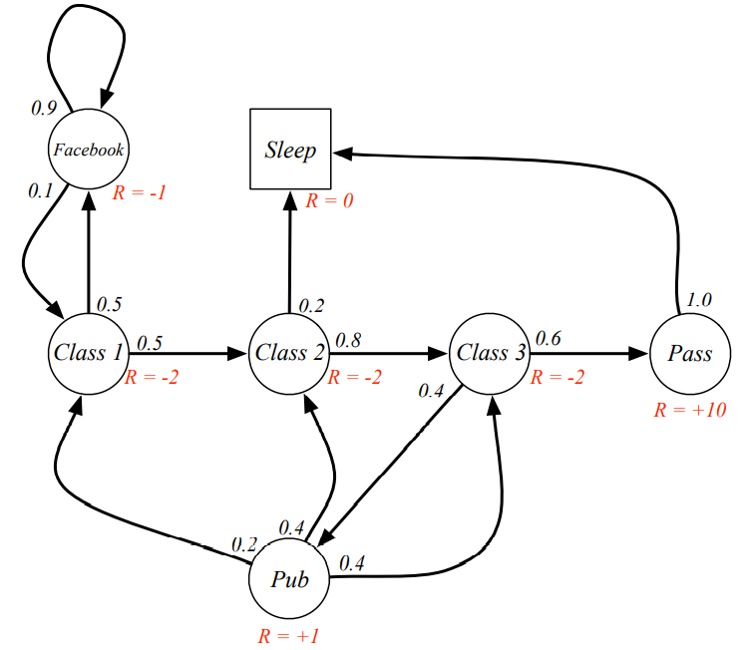
MDPs as a Graph
Another example:

Slide 11
Examples of MDPs
From the book:
Bioreactor – Suppose reinforcement learning is being applied to determine moment-by-moment temperatures and stirring rates for a bioreactor (a large vat of nutrients and bacteria used to produce useful chemicals).
Pick-and-Place Robot – Consider using reinforcement learning to control the motion of a robot arm in a repetitive pick-and-place task.
What other examples of tasks can you represent using the MDP framework?

Slide 12
MDP Notation
The reward and resultant state can be expressed as the output of functions taking only two parameters – current state and action
In the Sutton & Barto book, the following notation is used: p(s’, r | s, a)
The vertical bar is the symbol used for conditional probability
This function p() returns the probability (between 0 and 1)
Starting from state s
Taking action a
We wind up in state s’ and get reward r

Slide 13
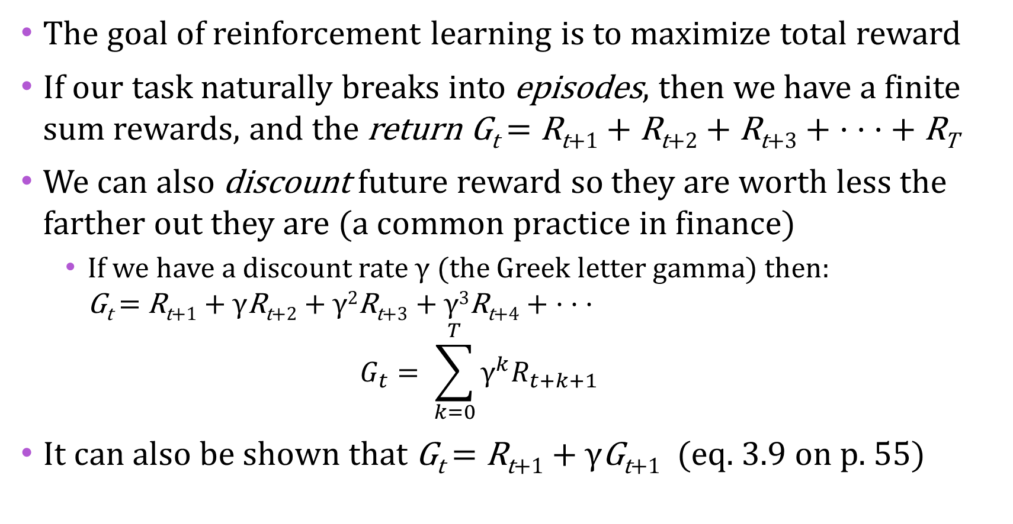
Goals and Rewards
The goal of reinforcement learning is to maximize total reward
If our task naturally breaks into episodes, then we have a finite sum rewards, and the return G_{t} = R_{t+1} + R_{t+2} + R_{t+3} + · · · + R_{T}
We can also discount future reward so they are worth less the farther out they are (a common practice in finance)
If we have a discount rate γ (the Greek letter gamma) then: G_{t} = R_{t+1} + γR_{t+2} + γ²R_{t+3} + γ³R_{t+4} + · · · $G_{t}= \sum_{k=0}^{T}{{\text{γ}}^{k}R_{t+k+1}}$
It can also be shown that G_{t} = R_{t+1} + γG_{t+1} (eq. 3.9 on p. 55)
It is useful to express a function recursively as a function of itself
Note

Slide 14
Policies and Value Functions
A policy gives the probability for each action a from state s only
A policy is represented by π, the Greek letter pi
The notation for the probability of action a in state s is π(a|s)
The value function of a state s when following policy π is the expected return (not immediate reward) when starting from s and choosing actions according to the policy π
This is denoted as v_{π}(s)
Similarly, the value of taking action a from state s when following policy π is the expected return (not immediate reward) starting from s, taking action a, and thereafter following policy π
This is denoted as q_{π}(s, a)

Slide 15
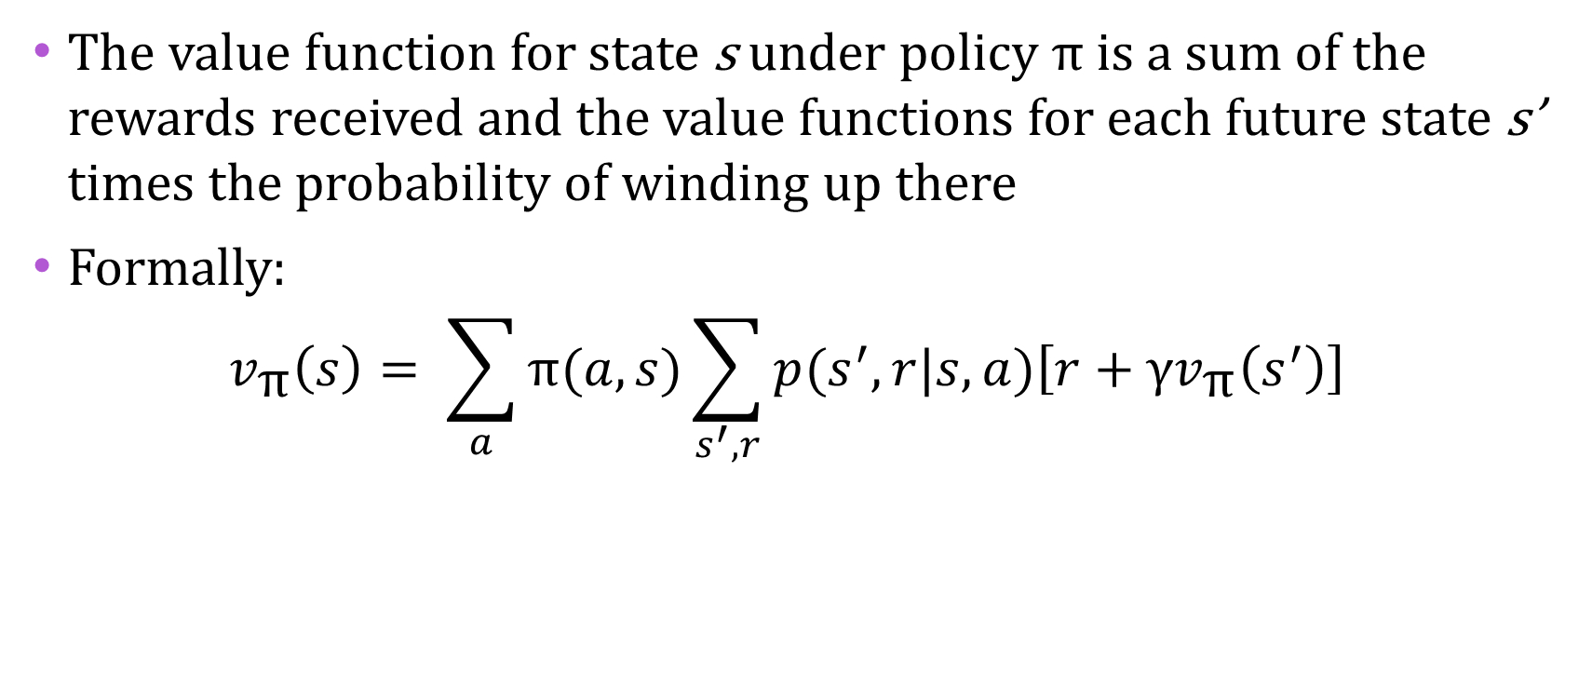
Bellman Equation
The value function for state s under policy π is a sum of the rewards received and the value functions for each future state s’ times the probability of winding up there
Formally: $v_{\text{π}}\left(s\right)= \sum_{a}{\text{π}(a,s)}\sum_{s^{′},r}{p(s^{′},r|s,a)\left[r+{\text{γ}v}_{\text{π}}\left(s^{′}\right)\right]}$
Probability you
take action a
Probability you
get reward r
and end in state s'
Reward plus discounted value of new state s’

Slide 16
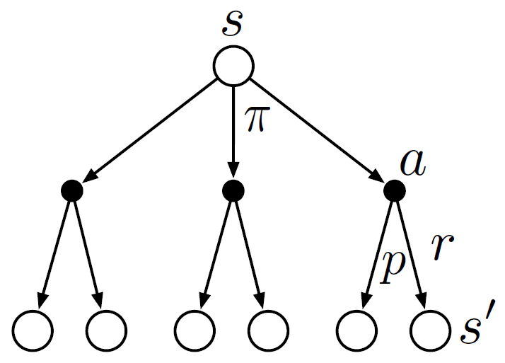
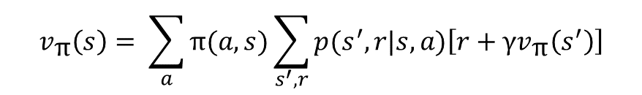
Bellman Equation Visualized
This is a backup diagram for v_{π}(s). To compute it:
We need to sum over each branch of π(), based on the probability of each action a
And sum over of each branch of p(), based on probability we wind up in state s’
The quantity we sum is the reward and the discounted value of possible state s’
$$v_{\text{π}}\left(s\right)= \sum_{a}{\text{π}(a,s)}\sum_{s^{′},r}{p(s^{′},r|s,a)\left[r+{\text{γ}v}_{\text{π}}\left(s^{′}\right)\right]}$$

Slide 17
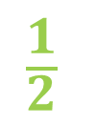
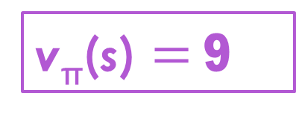
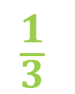
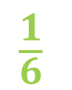
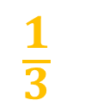
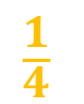
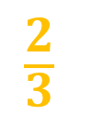
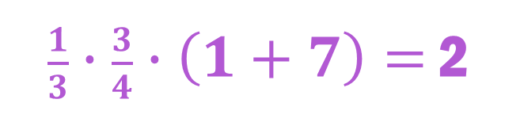
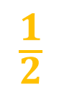
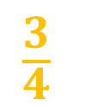
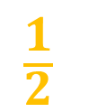
Bellman Equation Example
$$\frac{1}{3}$$
$$\frac{1}{6}$$
$$\frac{1}{2}$$
$$\frac{3}{4}$$
$$\frac{1}{4}$$
$$\frac{1}{2}$$
$$\frac{1}{2}$$
$$\frac{2}{3}$$
$$\frac{1}{3}$$
1
2
4
0
6
3
7
4
8
6
3
9
$\frac{1}{3}∙\frac{3}{4}∙\left(1+7\right)=$ 2
0.5
1
0.5
3
2
v_{π}(s) $=$ 9

Slide 18
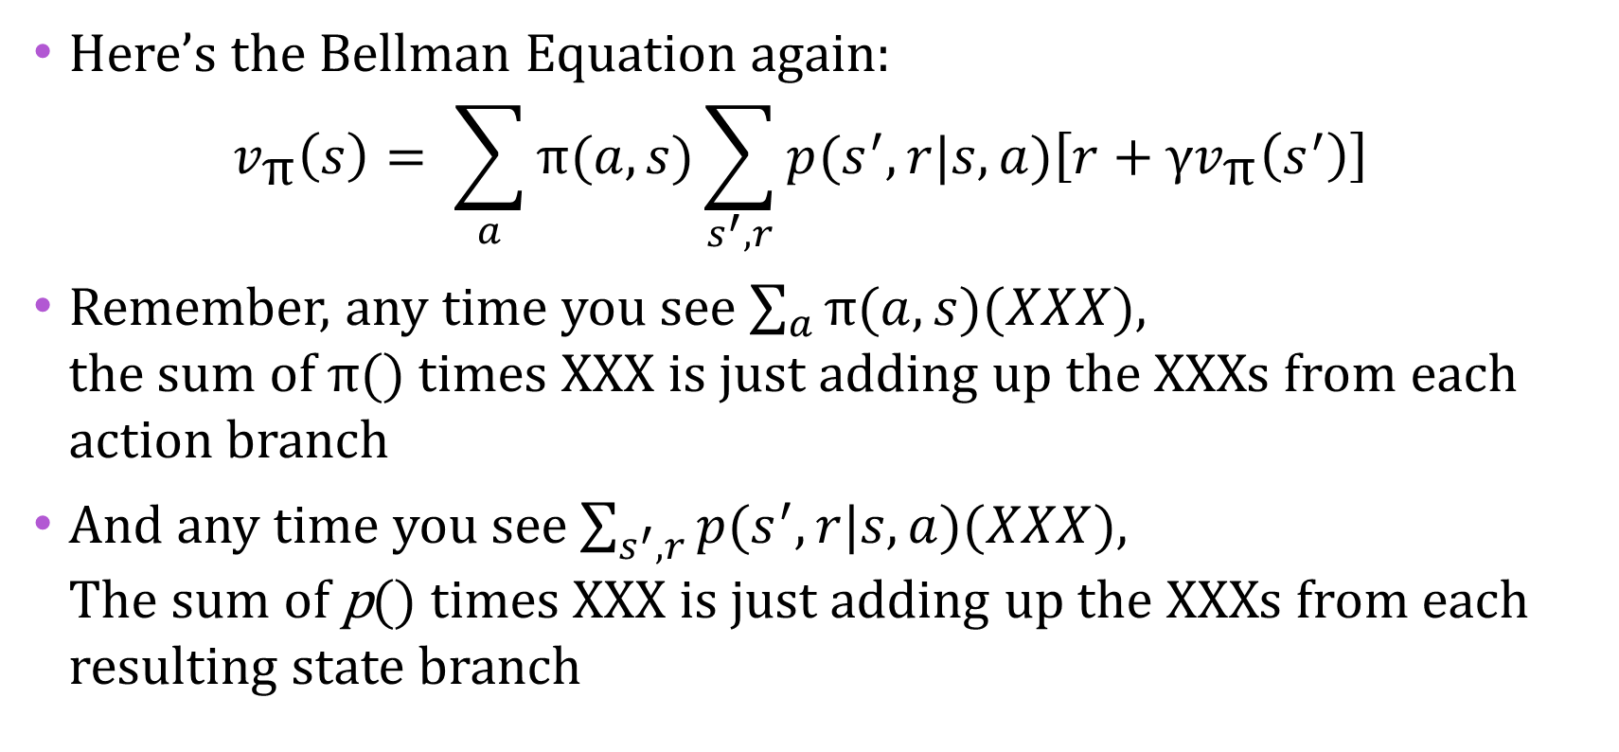
Bellman Equation Notes
Here’s the Bellman Equation again: $v_{\text{π}}\left(s\right)= \sum_{a}{\text{π}(a,s)}\sum_{s^{′},r}{p(s^{′},r|s,a)\left[r+{\text{γ}v}_{\text{π}}\left(s^{′}\right)\right]}$
Remember, any time you see $\sum_{a}{\text{π}(a,s)(XXX)}$, the sum of $\text{π}$() times XXX is just adding up the XXXs from each action branch
And any time you see $\sum_{s^{′},r}{p(s^{′},r|s,a)(XXX)}$, The sum of p() times XXX is just adding up the XXXs from each resulting state branch

Slide 19
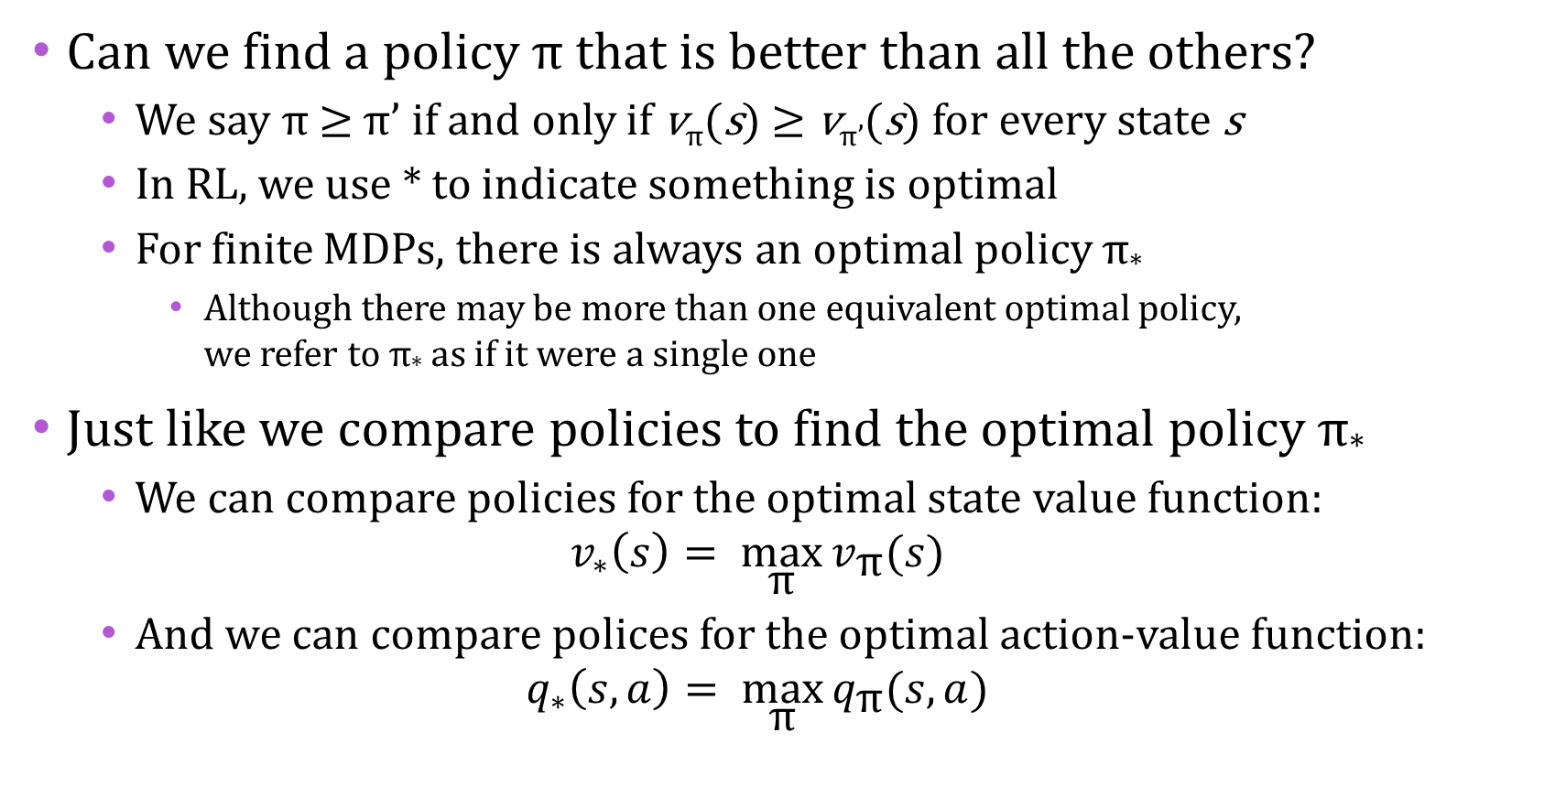
Optimal Policies
Can we find a policy π that is better than all the others?
We say π ≥ π’ if and only if v_{π}(s) ≥ v_{π’}(s) for every state s
In RL, we use * to indicate something is optimal
For finite MDPs, there is always an optimal policy π*
Although there may be more than one equivalent optimal policy, we refer to π* as if it were a single one
Just like we compare policies to find the optimal policy π*
We can compare policies for the optimal state value function: $v_{∗}\left(s\right)= \max_{\text{π}}{v_{\text{π}}(s)}$
And we can compare polices for the optimal action-value function: $q_{∗}\left(s,a\right)= \max_{\text{π}}{q_{\text{π}}(s,a)}$

Slide 20
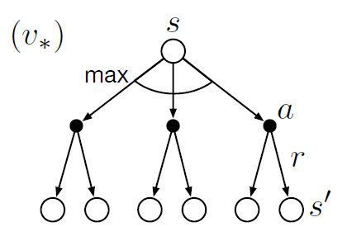
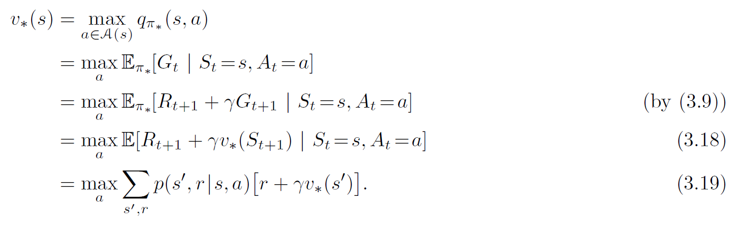
Bellman Optimality Equations
The Bellman optimality equation says the optimal value for a state must be the same as the return from the best action
We can rewrite it recursively

Slide 21
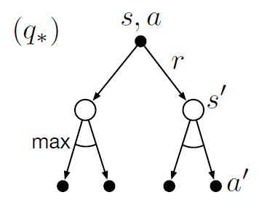
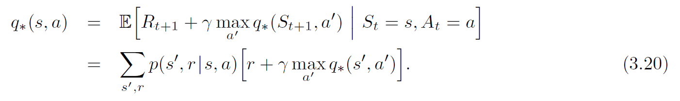
Bellman Optimality Equations
The Bellman optimality equation for state-action pairs is very similar.
The optimal value for a state-action pair must be the same as the return from the reward and best next action
It also can be written recursively

Slide 22
Bellman Optimality
For finite MDPs, the Bellman optimality equation (eq. 3.19) has a unique solution
With n states, you get n equations in n unknowns
If the function p(s’, r | s, a) – which captures the dynamics of your environment – is completely known, then you can solve for v*
You could also solve for q*
Once you have all values for v*, the optimal policy π* is the greedy one
You perform a one-step search of the results of each actions
If you know q*, it’s even easier. Choose the action with maximum q*
For small problems with known p, you can solve for the optimal policy through a brute force, exhaustive search

Slide 23
Approximating Optimality
To do the brute force method just mentioned, you need 3 things:
The dynamics of the environment are perfectly known
The states fully have the Markov property
You have enough memory and compute
E.g. backgammon has ~10²⁰ states
For lack of one or more of the above, we are approximating
In practice, all but the most trivial problems must be approximated
The field of reinforcement learning is about the study of ways to approximate value functions and find close to optimal policies

Slide 24
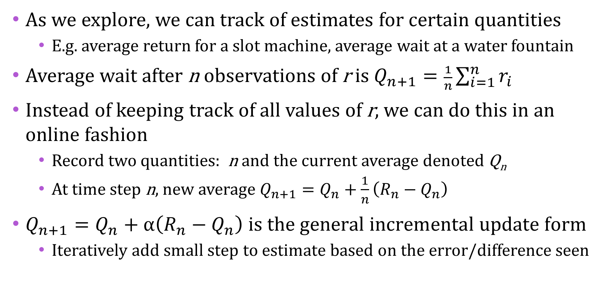
Incremental Estimation
As we explore, we can track of estimates for certain quantities
E.g. average return for a slot machine, average wait at a water fountain
Average wait after n observations of r is $Q_{n+1}=\frac{1}{n}\sum_{i=1}^{n}{r_{i}}$
Instead of keeping track of all values of r, we can do this in an online fashion
Record two quantities: n and the current average denoted Q_{n}
At time step n, new average $Q_{n+1}=Q_{n}+\frac{1}{n}\left(R_{n}−Q_{n}\right)$
$Q_{n+1}=Q_{n}+α\left(R_{n}−Q_{n}\right) \text{is} \text{the} \text{general} \text{incremental} \text{update} \text{form}$
Iteratively add small step to estimate based on the error/difference seen

Slide 25
Incremental Estimation
You can apply iterative improvement to your state value function or your state-action value function
This is exactly what we will discuss in the next few sessions
A lot of the difficulty with reinforcement learning is how to do this iteration in a way that converges
Reward design
Algorithms for learning
Getting model to converge quickly
Dealing with memory and compute limitations

Slide 26
Recap
Explain what reinforcement learning (RL) is and how it differs from supervised and unsupervised learning
Describe the basic elements of RL
Define RL in terms of Markov decision processes
Introduce the terminology and notation used in RL
Show the Bellman equations and simple ways to read them
Show how optimal solutions can be found for very simple RL problems
Share some of the challenges with general RL problems
Give a taste for what more advanced RL algorithms do

Slide 27
Reinforcement Learning Notation
Letter | Used for
s | State
a | Action
r | Reward
γ | Discount rate
p | Transition probability
v | Value function for states
q | Value function for state-action pairs
π | Policy (πολιτική)
* | Optimal choices, e.g. π*

Slide 28
Questions & Discussion

Slide 29
Next Session
We will finish the content of these slides next week, Sat. May 22
The following session will be about Dynamic Programming and Monte Carlo methods for reinforcement learning
This material is in chapters 4 & 5 of Sutton & Barto
We will likely skip Sat. May 29 (which is Memorial Day weekend) and discuss Dynamic Programming and Monte Carlo methods on Sat. June 5

